Slide 1
ASSISTIVE TECHNOLOGY & INNOVATION
Devices for the Handicapped
Presenters: Filip Bureš & David Švancar
Notes:
Slide 1 – Title Slide Hello everyone. My name is Filip, and this is David. Today we will talk about devices for the handicapped. We will show you how computers, robots, and our university TUL help disabled people. SOS: Our presentation is about technology for people with disabilities.

Slide 2
01 / DAILY CHALLENGES
Difficulties with Standard Computers
Vision Limitations
Mobility Limitations
•
Small Text: Hard to read standard monitors.
•
Standard Mouse: Needs fine hand movement.
•
Mouse Cursor: Easy to lose on screen.
•
Small Keys: Hard to press one key.
•
Visual Icons: Pictures have no sound description.
•
Muscle Weakness: Hands get tired very quickly.
•
•
Paralysis: Some users cannot move hands.
Low Contrast: Bright screens hurt weak eyes.
Notes:
Slide 2 – 01 / Daily Challenges Using a normal computer is hard for some people. People with bad eyes cannot see small text or the mouse cursor on the screen. People with mobility problems cannot move a standard mouse or press small keys on a keyboard. SOS: Blind and paralyzed people cannot use a normal mouse and keyboard.

Slide 3
02 / WHY IT MATTERS
Global Need for Assistive Tech
1.3 Billion
People worldwide live with a major disability (WHO)
Smart devices help them study, work, and talk to friends.
Notes:
Slide 3 – 02 / Why It Matters Why is this topic important? About 1.3 billion people in the world have a big disability. Smart technology helps these people every day. With special devices, they can study, work, and talk to friends. SOS: Smart devices help disabled people live a normal life.

Slide 4


03 / INPUT DEVICES
Controlling a PC Without Hands
Eye Tracking
Sip-Puff Switch
Voice Control
Camera follows eye movement.
Breath pressure controls mouse clicks.
Spoken commands type text fast.
Notes:
Slide 4 – 03 / Input Devices How can people control a computer without hands? They use special input devices. With eye tracking, a camera watches their eyes and moves the mouse. With a sip-puff switch, they blow air into a tube to click. Or they just use their voice. SOS: People can control a computer with their eyes, breath, or voice.

Slide 5

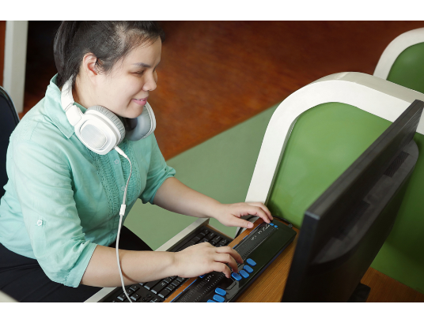
04 / OUTPUT DEVICES
How Computers Talk Back
•
Braille Display: Small pins move up to create tactile letters.
•
Touch Reading: Blind users read websites with their fingers.
•
Screen Readers: Software reads screen text into headphones.
•
Speech Synthesizers: Computer speaks aloud for mute users.
Notes:
Slide 5 – 04 / Output Devices How does the computer talk back to blind or mute people? A Braille display has small pins that go up and down. Blind users read the text with their fingers. A screen reader is a program that reads the website aloud into headphones. SOS: Blind people can listen to the computer or read Braille with their fingers.

Slide 6




05 / SOFTWARE ACCESSIBILITY
Special Features in Everyday Apps
Voice Assistants
High Contrast Mode
Hands-free phone control via speech.
Large letters for weak eyes.
Live Captions
Smart Home Apps
Automatic subtitles for every video.
One tap opens locked doors.
Notes:
Slide 6 – 05 / Software Accessibility Normal phones and apps also have special features to help. Voice assistants let you control the phone by speaking, and high contrast mode makes letters big and clear. Live captions make automatic subtitles for deaf people, and smart home apps can open doors with one tap. SOS: Everyday phones help people with voice control, big letters, and automatic subtitles.

Slide 7

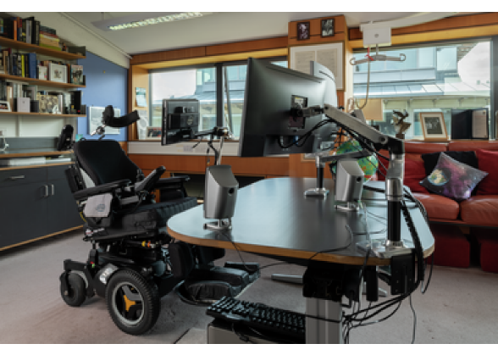
06 / FAMOUS CASE STUDY
Stephen Hawking’s Computer System
Paralyzed by ALS, speaking through one muscle:
•
Cheek Sensor: Infrared switch on glasses detects cheek movement.
•
Intel ACAT System: Screen cursor scans letters automatically.
•
Word Prediction: Smart software guesses the next word.
•
Voice Box: Synthesizer speaks the finished sentence aloud.
Notes:
Slide 7 – 06 / Famous Case Study: Stephen Hawking A famous example was the scientist Stephen Hawking. He was paralyzed by ALS disease. He had a small infrared sensor on his glasses. It watched one muscle in his cheek. Smart software from Intel guessed his words, and a voice box spoke for him. Now, David will continue. SOS: Stephen Hawking controlled his computer with one muscle in his cheek.

Slide 8



07 / ASSISTIVE ROBOTICS
Robots and Robotic Arms
Wheelchair Arms
Home Care Robots
Smart Wheelchairs
Robotic hands hold cups safely.
Mobile helpers bring daily medicine.
Laser sensors stop before obstacles.
Notes:
Slide 8 – 07 / Assistive Robotics Thank you, Filip. Now let's look at assistive robots. Robotic arms on a wheelchair help people hold a cup of water or open doors. Home care robots bring medicine, and smart wheelchairs have laser sensors so they do not crash. SOS: Robotic arms and smart wheelchairs help paralyzed people at home.

Slide 9
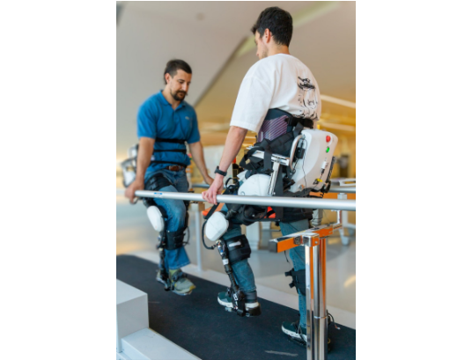
08 / WEARABLE ROBOTS
Exoskeletons and Exosuits
•
Hard Exoskeleton: Metal robot suit with electric motors.
•
Standing Up: Helps paralyzed people walk in therapy.
•
Soft Exosuit: Light fabric suit with small pull cables.
•
Daily Support: Gives extra power to weak leg muscles.
Notes:
Slide 9 – 08 / Wearable Robots People can also wear robots on their body like a suit. A hard exoskeleton is made of metal and has electric motors. It helps paralyzed people stand up and walk. A soft exosuit is made of light fabric with small cables. It gives extra power to weak legs. SOS: An exoskeleton is a robot suit that helps paralyzed people walk again.

Slide 10
09 / LOCAL RESEARCH IN LIBEREC
How TUL Helps People with Disabilities
01 / CXI TUL
02 / TUL & Hospital
03 / TUL Campus
3D-Printed Grips for Kids
Custom 3D Orthoses
Support for Students
Colorful holders for spoons or pencils at Liberec special kindergarten.
Biomechanics team prints custom bone models for Liberec Hospital patients.
Special Braille lines help blind students study at our university.
Notes:
Slide 10 – 09 / Local Research in Liberec Our university in Liberec, TUL, also helps people with disabilities. First, CXI TUL uses 3D printers to make colorful holders for spoons and pencils for kids in a special kindergarten. Second, TUL prints 3D bone models and orthoses for Liberec Hospital. Third, our campus has Braille lines for blind students. SOS: Our university TUL makes 3D-printed tools for kids, hospitals, and blind students.

Slide 11
10 / CURRENT RESEARCH & SUPPORT
New Trends, Support, and Our Idea
Current Research
Support & Our Idea
•
Brain Chips (BCI): Controlling a computer just by thinking.
•
Financial Support: Health insurance helps pay for devices.
•
AI Smart Glasses: Camera describes the street to blind users.
•
Non-Profits: Charities train users to control new tech.
•
Bionic Hands: Prosthetics connected directly to nerves.
•
Our Idea: Cheap 3D-printed phone holder controlled by head movement.
Notes:
Slide 11 – 10 / Current Research & Support What is new in research today? Scientists are making brain chips so people can control a PC just by thinking. There are also AI smart glasses for blind people and bionic hands. Health insurance and charities help pay for them. And our own idea is a cheap 3D-printed phone holder controlled by simple head movement. SOS: New research includes brain chips and AI glasses, and our idea is a 3D-printed phone holder.

Slide 12
11 / EVALUATION & LIMITATIONS
Pros, Cons, and Limitations
Advantages (Pros) | Limitations (Cons)
More independence at home | Very high price of robots
Easy communication with family | Short battery life outdoors
Better chance to find a job | Long training needed for users
Fast connection to online school | Difficult repairs when broken
Notes:
Slide 12 – 11 / Evaluation & Limitations Every technology has advantages and limitations. The good things are more independence at home, easy talking with family, and finding a job or online school. The bad things are the very high price, short battery life outside, long training, and hard repairs. SOS: These devices give people freedom, but they are very expensive and need charging.

Slide 13
CLASS DISCUSSION
Questions?
1.
What sort of difficulties are experienced by computer users with limitations of vision or mobility?
2.
How, in what ways can these people communicate with a computer?
3.
What IT assistive technology devices do you know?
4.
Do you have some innovative ideas yourself?
5.
What do you know about TUL doing research and developing devices for the handicapped?
6.
Specific features to apps?
Notes:
Slide 13 – 12 / References Here you can see our information sources from the World Health Organization, our university TUL, and Intel. SOS: Here are the sources we used for our presentation.

Slide 14
12 / REFERENCES
Sources
•
World Health Organization (WHO): Global Report on Assistive Technology (who.int)
•
Technical University of Liberec (TUL): CXI TUL 3D Printing & Biomechanics Research (tul.cz)
•
Intel Corp: Stephen Hawking ACAT Assistive Context-Aware Toolkit (intel.com)
•
Wikipedia

Slide 15



Image Sources
https://accessibleweb.com/wp-content/uploads/2020/08/shutterstock_1763944685.jpg
Source: accessibleweb.com
https://www.sciencemuseum.org.uk/sites/default/files/styles/carousel/public/2022-11/Desk%20Image%201.png?itok=486CdGv2
Source: www.sciencemuseum.org.uk
https://healthcare-in-europe.com/media/story_section_text/45309/image-01-exoskeleton-walk-training_hires.jpg
Source: healthcare-in-europe.com

